Slide 1
IST 210 Organization of Data SQL Joins
Dr. S. Gokhan Ozden
gokhan@psu.edu

Slide 2
SQL JOIN
It's a clause you can use in your SELECT statement to get information that's in a another table
The Orders table holds the CustomerID on who placed the order
But that customer's name is in a different table called Customers
So, you can do one SELECT statement which takes information from more than one table

Slide 3
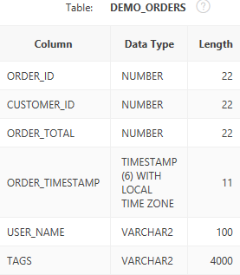
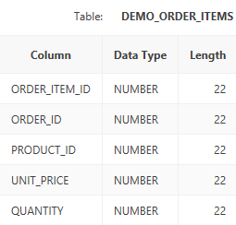
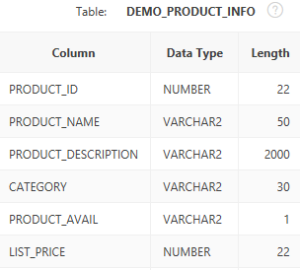
Relations Among Tables
Orders, Product_Info, and [Order_Items], are related
Each has their own unique record/row identifiers
Orders has OrderID
Product_Info has ProductID
[Order_Items] has Order_Item_ID

Slide 4
Relations Among Tables
[Order_Items].Order_ID, is a foreign key (FK)
It refers to the primary key (PK) Orders.Order_ID
[Order_Items].Product_ID is a foreign key (FK)
It refers to the PK Product_Info.Product_ID

Slide 5
Using The Relations To Find Info
Now we will use the relationships to solve a problem: Given an order, find the names of the items on that order
We won't use JOIN yet
Afterward, we'll see how JOIN makes it easier

Slide 6
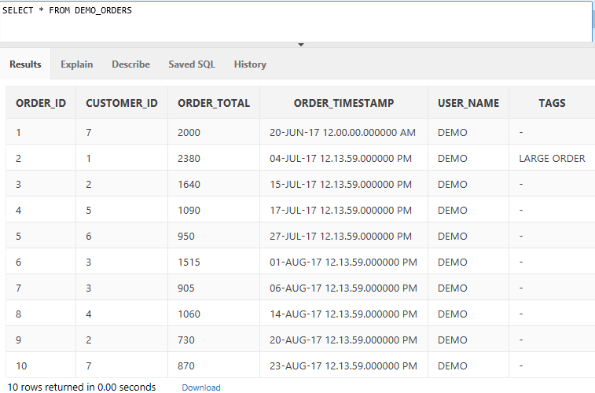
Exploring Orders
Here's an order with a Order_ID of 1
Let's find out the name of the items on the order…

Slide 7
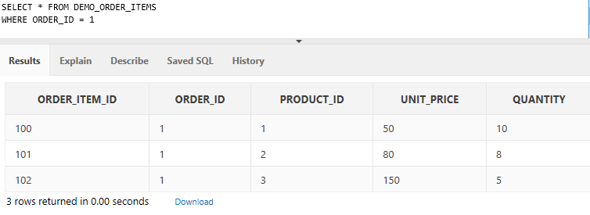
Exploring Orders
The names of the items are not here!
But their ProductIDs are
Now let's get their names…
FK pointing to the PK Product_INFO.Product_ID
This order has 3 items on it

Slide 8
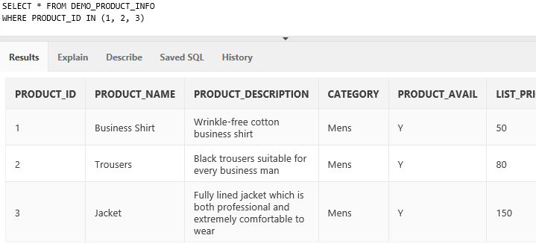
Exploring Orders
Finds the items whose ProductID appears in this list

Slide 9
Using JOIN Instead
Some hassles with finding records that way:
We needed to use multiple SELECT statements
We needed to manually list IDs to find
The records appeared in different results sections
JOIN is a SQL clause that lets you
Search multiple tables using one SELECT
Not need to manually deal with IDs
Have all results appear in one section

Slide 10
Order 1 Using JOIN
Previously, we had these two SELECTs
When using JOIN, we'd write this:
SELECT *
FROM Demo_Order_Items AS oi
WHERE oi.Order_ID = 1
SELECT * FROM DEMO_PRODUCT_INFO p
WHERE p.Product_ID IN (1, 2, 3)
SELECT oi.*, p.*
FROM DEMO_ORDER_ITEMS oi
JOIN DEMO_PRODUCT_INFO p
ON (p.Product_ID = oi.Product_ID)
WHERE oi.Order_ID = 1

Slide 11
What is JOIN Doing?
You need to use table aliases and asterisk for each table to list all columns from each table
SELECT oi.*, p.*
FROM DEMO_ORDER_ITEMS oi
JOIN DEMO_PRODUCT_INFO p
ON (p.Product_ID = oi.Product_ID)
WHERE oi.Order_ID = 1
The table you are joining
JOIN acts like FROM in the sense that you are naming another table you want to use
ON acts like WHERE in that it restricts the kind of records you want returned to you
The ON clause is where you utilize the relationship with other tables
JOIN always needs to have an ON clause
Just like WHERE, the ON clause involves columns
You cannot simply put just the table names in there

Slide 12
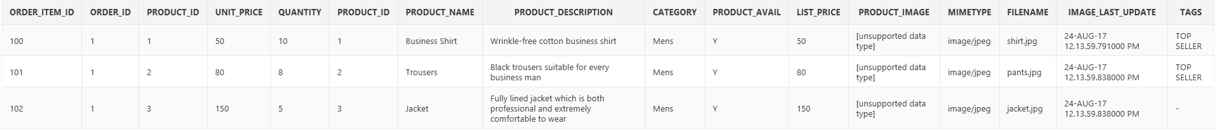
Let's Choose Only The Columns We Want To Display
Asterisk includes all fields from all tables in the statement
All Order_Items columns (5), and all Product_Info columns (12)
SELECT oi.*, p.*
FROM DEMO_ORDER_ITEMS oi
JOIN DEMO_PRODUCT_INFO p
ON (p.Product_ID = oi.Product_ID)
WHERE oi.Order_ID = 1

Slide 13
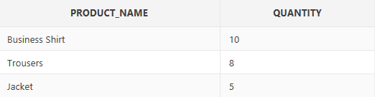
Let's Choose Only The Columns We Want To Display
So, let's just pick the fields we want
SELECT p.Product_Name, oi.Quantity
FROM DEMO_ORDER_ITEMS oi
JOIN DEMO_PRODUCT_INFO p
ON (p.Product_ID = oi.Product_ID)
WHERE oi.Order_ID = 1

Slide 14
JOINs Are Tricky To Learn
Why? Because there is almost always more than one way to get the answer
If you have a SELECT with a WHERE and a JOIN, that's 2 tables
Most of the time, you can switch the tables, and get the same results

Slide 15
JOINs Are Tricky To Learn
These give the same results:
But the first one is preferable, because the WHERE clause refers to the same table as the FROM clause
SELECT p.*, oi.*
FROM DEMO_ORDER_ITEMS oi
JOIN DEMO_PRODUCT_INFO p
ON (p.Product_ID = oi.Product_ID)
WHERE oi.Order_ID = 1
Here, the FROM uses [Order_Items] and JOIN uses Product_Info
SELECT p.*, oi.*
FROM DEMO_PRODUCT_INFO p
JOIN DEMO_ORDER_ITEMS oi
ON (p.Product_ID = oi.Product_ID)
WHERE oi.Order_ID = 1
Here, the FROM uses Product_Info and JOIN uses [Order_Items]

Slide 16
Equi Join (Oracle SQL)
An equijoin is a join with a join condition containing an equality operator. An equijoin combines rows that have equivalent values for the specified columns.
SELECT p.*, oi.*
FROM DEMO_ORDER_ITEMS oi, DEMO_PRODUCT_INFO p
WHERE p.Product_ID = oi.Product_ID
AND oi.Order_ID = 1

Slide 17
Exercise 1
Write a SELECT that returns these from Demo_Orders:
Order_ID
Customer_ID
Make sure that runs correctly
The Demo_Orders table has an Customer_ID field
Now we want 2 columns returned
The customer’s first name
The customer's last name
So add a JOIN to the Customers table

Slide 18
Exercise 1
SELECT ORDER_ID, CUSTOMER_ID
FROM DEMO_ORDERS
SELECT c.Cust_First_Name AS "First Name", c.Cust_Last_Name AS "Last Name", o.Order_ID AS "Order ID"
FROM DEMO_ORDERS o
JOIN DEMO_CUSTOMERS c
ON (o.Customer_ID = c.Customer_ID)

Slide 19
Exercise 2
Modify your SQL from Exercise 1 to include the product IDs of the order
You'll first need to figure out:
What table holds the product IDs?
What is the primary key and foreign key involved?
Then just add a new JOIN clause above or below the existing one

Slide 20
Exercise 3
Modify your SQL from Exercise 2
Only return those orders whose ORDER_TOTAL is greater than 1000

Slide 21
Exercise 4
Modify your SQL from Exercise 4
Include the product name of the items rather than Product ID
Hints
The FK is Demo_Order_Items.Product_ID
It refers to the PK Demo_Product_Info.Product_ID
A FK is not required to have the same name as the corresponding PK.

Slide 22
Other JOINs
Plain JOIN is the same as what's called an INNER JOIN
An INNER JOIN will only return records in which the ON clause matches
You may want non-matches returned also
For that, you can use the outer joins
LEFT OUTER JOIN
RIGHT OUTER JOIN
FULL OUTER JOIN
Next slide explains what LEFT and RIGHT are...

Slide 23
"Left" and "Right" Tables
SELECT
o.Customer_ID
,o.Order_ID
,oi.Product_ID
,c.Cust_First_Name
FROM DEMO_ORDERS o
JOIN DEMO_CUSTOMERS c
ON c.Customer_ID = o.Customer_ID
JOIN DEMO_ORDER_ITEMS oi
ON oi.ORDER_ID = o.ORDER_ID
The left table is indicated by the FROM keyword
The right table(s) is/are indicated by the JOINs
x

Slide 24
Create a New Customer
To see how this works, we need to create a new customer
INSERT INTO DEMO_CUSTOMERS (
Cust_First_Name
,Cust_Last_Name
) VALUES (
‘John'
,’Doe'
)
Since all the other attributes are NULLABLE we don’t have to add them into our INSERT clause.
John Doe has no State (all of his other attributes are NULL).

Slide 25
LEFT OUTER JOIN (aka "left join")
To include rows from your left table
The table named with the FROM
Even if no matching rows in the right table(s)
The table(s) you are joining to
The left table is indicated by the FROM keyword
SELECT
c.Cust_First_Name
,c.Cust_Last_Name
,s.State_Name
FROM DEMO_CUSTOMERS c
LEFT OUTER JOIN DEMO_STATES s
ON c.Cust_State = s.ST
The right table(s) is/are indicated by the JOINs

Slide 26
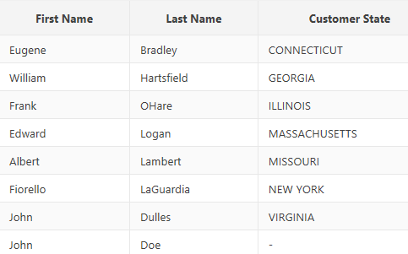
LEFT OUTER JOIN (aka "left join")
Results when using LEFT OUTER JOIN
SELECT
c.Cust_First_Name
,c.Cust_Last_Name
,s.State_Name
FROM DEMO_CUSTOMERS c
LEFT OUTER JOIN DEMO_STATES s
ON c.Cust_State = s.ST
And in the lower-right of the screen, the count
Customer State is NULL here because there was no corresponding State
This would have been 7 if we used INNER JOIN

Slide 27
RIGHT OUTER JOIN (aka “right join")
To include all rows from your right table(s)
The table(s) you are JOINing to
But are not in the left table
The table named with the FROM
The left table is indicated by the FROM keyword
SELECT
c.Cust_First_Name
,c.Cust_Last_Name
,s.State_Name
FROM DEMO_CUSTOMERS c
RIGHT OUTER JOIN DEMO_STATES s
ON c.Cust_State = s.ST
The right table(s) is/are indicated by the JOINs

Slide 28
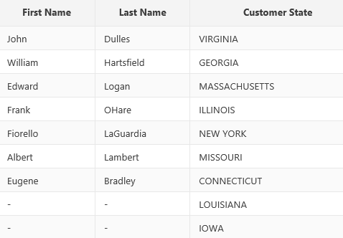

RIGHT OUTER JOIN (aka "right join")
Results when using RIGHT OUTER JOIN
SELECT
c.Cust_First_Name
,c.Cust_Last_Name
,s.State_Name
FROM DEMO_CUSTOMERS c
RIGHT OUTER JOIN DEMO_STATES s
ON c.Cust_State = s.ST
Our count went up from 7 with INNER JOIN to 51 with RIGHT OUTER JOIN
Because there are total 51 states including D.C.
First and Last Names are both NULL
because no such Customers record

Slide 29
FULL OUTER JOIN (aka "full join")
Combination of LEFT OUTER JOIN and RIGHT OUTER JOIN
Include customers that have no states AND
Include states that have no customers

Slide 30
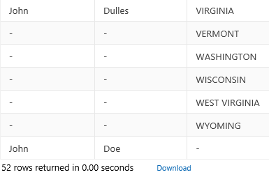
FULL OUTER JOIN (aka "full join")
Results when using FULL OUTER JOIN
SELECT
c.Cust_First_Name
,c.Cust_Last_Name
,s.State_Name
FROM DEMO_CUSTOMERS c
FULL OUTER JOIN DEMO_STATES s
ON c.Cust_State = s.ST
Why 52 records?
7 from what the INNER JOIN would give you
+1 from LEFT OUTER JOIN, +44 from RIGHT OUTER JOIN
44 states that have no customers
1 customer that has no state

Slide 31
How To Decide?
JOIN / LEFT JOIN
If you require an ON match for each row
LEFT OUTER JOIN
To get all left rows, even those that have no ON matches in any of the right tables
RIGHT OUTER JOIN
To get all right rows, even those that have no ON matches in the left table
FULL OUTER JOIN
To get all right and left rows, regardless of ON matches

